Slide 1
Mining Top-K High Utility Itemsets
Date: 2013/04/08
Author: Cheng Wei Wu, Bai-En Shie, Philip S. Yu, Vincent S. Tseng
Source: KDD ’12
Advisor: Dr. Jia-Ling Koh
Speaker: Yi-Hsuan Yeh

Slide 2
Outline
Introduction
Problem definition
Mining top-k high utility
Baseline approach
Effective strategies
Experiments
Conclusion

Slide 3
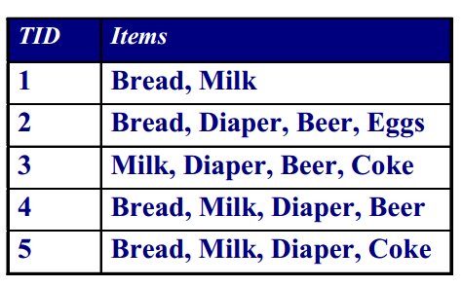
Introduction
Mining high utility intems：discovery of itemsets with utilities higher than a user-specified minimum utility threshold min_util.

Slide 4
Introduction
Setting an appropriate minimum utility threshold is a difficult problem for users.
User need to try different threshold by guessing and re-executing.
inconvenient
time-consuming
Setting k is more intuitive than setting the threshold because k represents the number of itemsets that the user wants to find.

Slide 5
Introduction
Propose a new framework named TKU(Top-K Utility itemsets mining) for mining top-k high utility itemsets without setting min-util.
top-k high utility itemsets
Transactions
UP-Growth
UP-Tree
potential top-k high utility itemsets(PKHUIs)

Slide 6
Outline
Introduction
Problem definition
Mining top-k high utility
Baseline approach
Effective strategies
Experiments
Conclusion

Slide 7
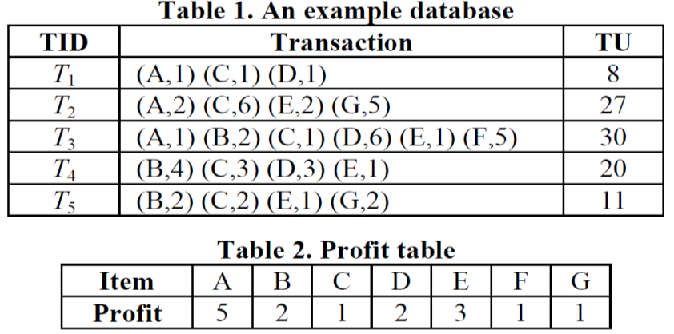
Problem definition
I = {i1, i2, … , im}：a set of items.
D = {T1, T2, … , Tn}：a transaction database where each transaction is a subset of I.
p(ij , D)： external utility (profit), a weight of an item
q(ij ,Tc)：internal utility, the quantity of the item sold in the transaction.
Ex：
p(A , D) = 5 p(C , D) = 1
q(A ,T1) = 1 q(D ,T3) = 6

Slide 8
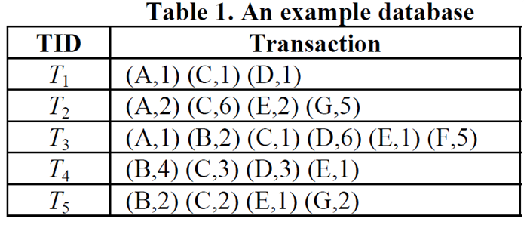
An itemset X = {i1, i2, … , il} is a set of l distinct items, where ij∈I, 1 ≤ j ≤ l, and l is the length of X.
Ex:
X = {B,C}
SC(X) = 3
support(X) = 3/5

Slide 9
Ex:
u(A,T1) = 5*1 = 5
u(C,T1) = 1*1 = 1
X = {A,C}
u(X,T1) = u(A,T1) + u(C,T1) = 6
u(X) = u(X,T1) + u(X,T2) + u(X,T3)
= 6 + (5*2+1*6) + (5*1+1*1)
= 28

Slide 10
high utility itemset：u(X) ≥ min_util
𝑓𝐻(D, min_util) ：the set of high utility itemset in D.

Slide 11
downward closure property：any subset of a frequent itemset must also be frequent.
We can not use the downward closure property to purn the search space.
Ex:
u(X) = u(X,T1) + u(X,T2) + u(X,T3)
= (5*1) + (5*2) + (5*1)
= 20
u(Y) = u(Y,T1) + u(Y,T2) + u(Y,T3)
= (5*1+1*1) + (5*2+1*6) + (5*1+1*1)
= 28
Assume ：
X = {A} , Y = {A,C}, min_util = 25
{A} is a low utility item, but its superset {A, C} is a high utility itemset.

Slide 12
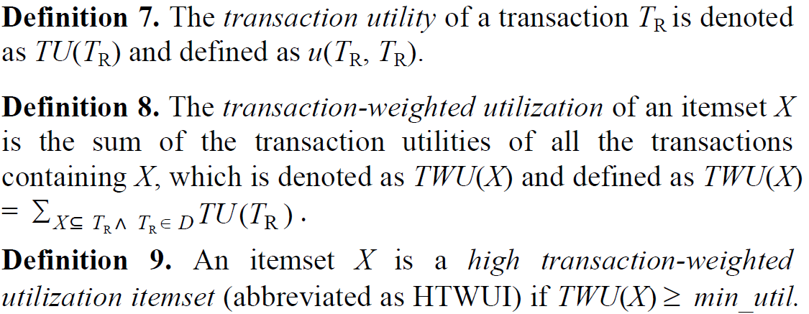
TU(T1) = u(A,T1) + u(C,T1) + u(D,T1)
= (5*1) + (1*1) + (2*1) = 8
Assume： X = {A,C}
TWU(X) = TU(T1) + TU(T2) + TU(T3)
= 8 + 27 + 30
= 65

Slide 14
Outline
Introduction
Problem definition
Mining top-k high utility
Baseline approach
Effective strategies
Experiments
Conclusion

Slide 15
Mining top-k high utility
Baseline approach
Phase I
Construction of UP-Tree
Generation of potential top-k high utility itemsets(PKHUIs)： UP-Growth
Phase II
Identifying top-k high utility itemsets from PKHUIs
Effective strategies

Slide 16
Outline
Introduction
Problem definition
Mining top-k high utility
Baseline approach
Effective strategies
Experiments
Conclusion

Slide 17
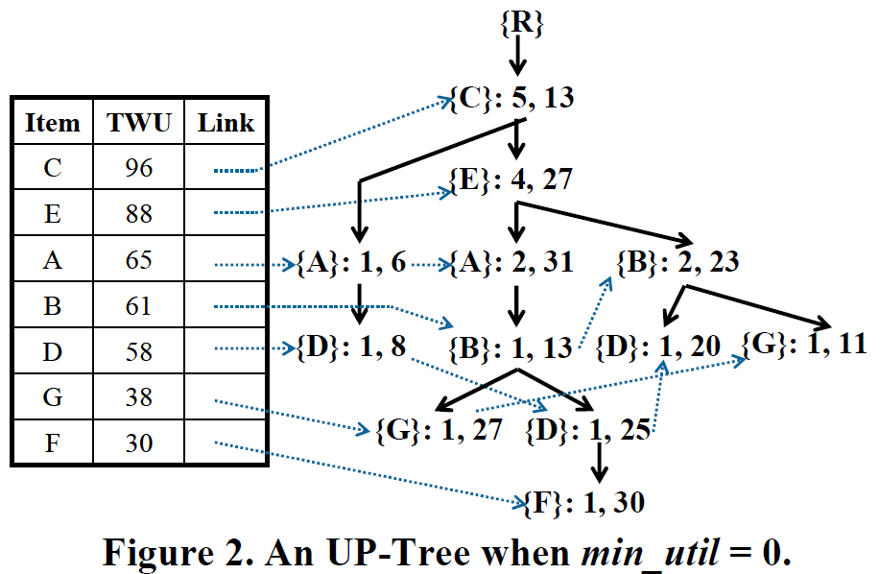
Phase I UP-Tree structure
Header table
N.name
N.count
N.nu (node utility)
N.parent
N.link

Slide 18
Construction of UP-Tree
Build header table
Any item’s TWU > min_util will be discarded from transaction
Sort each items in every transaction
For each transaction build UP-Tree

Slide 19
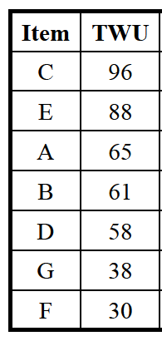
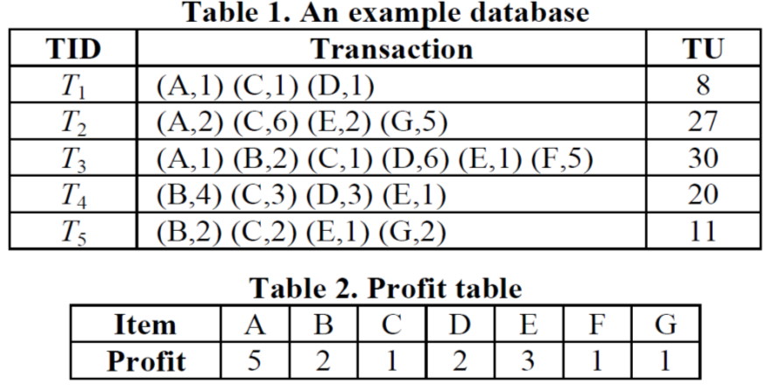
Assume：
min_util = 0
Header table
TID | Transaction
T1 | (C,1) (A,1) (D,1)
T2 | (C,6) (E,2) (A,2) (G,5)
T3 | (C,1) (E,1) (A,1) (B,2) (D,6) (F,5)
T4 | (C,3) (E,1) (B,4) (D,3)
T5 | (C,2) (E,1) (B,2) (G,2)
R
N.nu：Sum of the utilities of the items which are before the item.
count
C：1,1
A：1,6
C.nu = 1*1 = 1
A.nu = (1*1) + (5*1) = 6
D.nu = (1*1) + (5*1) + (2*1) = 8 = TU(T1)
D：1,8

Slide 20
Header table
TID | Transaction
T1 | (C,1) (A,1) (D,1)
T2 | (C,6) (E,2) (A,2) (G,5)
T3 | (C,1) (E,1) (A,1) (B,2) (D,6) (F,5)
T4 | (C,3) (E,1) (B,4) (D,3)
T5 | (C,2) (E,1) (B,2) (G,2)
R
C：2,7
A：1,6
E：1,12
C.nu = 1 + (1*6) = 7
E.nu = (1*6) + (3*2) = 12
A.nu = (1*6) + (3*2) + (5*2) = 22
G.nu = TU(T2) = 27
D：1,8
A：1,22
G：1,27

Slide 21
Header table
TID | Transaction
T1 | (C,1) (A,1) (D,1)
T2 | (C,6) (E,2) (A,2) (G,5)
T3 | (C,1) (E,1) (A,1) (B,2) (D,6) (F,5)
T4 | (C,3) (E,1) (B,4) (D,3)
T5 | (C,2) (E,1) (B,2) (G,2)
R
C：3,8
C.nu = 7 + (1*1) = 8
E.nu = 12 + (1*1) + (3*1) = 16
A.nu = 22 + (1*1) + (3*1) + (5*1) = 31
B.nu = (1*1) + (3*1) + (5*1) + (2*2) = 13
D.nu = (1*1) + (3*1) + (5*1) + (2*2) + (2*6) = 25
F.nu = TU(T3) = 30
A：1,6
E：2,16
D：1,8
A：2,31
B：1,13
G：1,27
D：1,25
F：1,30

Slide 22
Header table
TID | Transaction
T1 | (C,1) (A,1) (D,1)
T2 | (C,6) (E,2) (A,2) (G,5)
T3 | (C,1) (E,1) (A,1) (B,2) (D,6) (F,5)
T4 | (C,3) (E,1) (B,4) (D,3)
T5 | (C,2) (E,1) (B,2) (G,2)
R
C：4,11
A：1,6
E：3,22
C.nu = 8 + (1*3) = 11
E.nu = 16 + (1*3) + (3*1) = 22
B.nu = (1*3) + (3*1) + (2*4) = 14
D.nu = TU(T4) = 20
D：1,8
A：2,31
B：1,14
G：1,27
B：1,13
D：1,20
D：1,25
F：1,30

Slide 23
Header table
TID | Transaction
T1 | (C,1) (A,1) (D,1)
T2 | (C,6) (E,2) (A,2) (G,5)
T3 | (C,1) (E,1) (A,1) (B,2) (D,6) (F,5)
T4 | (C,3) (E,1) (B,4) (D,3)
T5 | (C,2) (E,1) (B,2) (G,2)
R
C：5,13
C.nu = 11 + (1*2) = 13
E.nu = 22 + (1*2) + (3*1) = 27
B.nu = 14 + (1*2) + (3*1) + (2*2) = 23
G.nu = TU(T5) = 11
A：1,6
E：4,27
D：1,8
A：2,31
B：2,23
G：1,27
B：1,13
D：1,20
G：1,11
D：1,25
F：1,30

Slide 24
Generating PKHUIs from the UP-Tree：UP-Gorwth
Ex：
Assume ： X = {A,C}
miu(A) = u(A,T1) = u(X,T2) = 5*1 = 5
MIU(X) = (miu(A) + miu(C))*3
= ((5*1) + (1*1))*3
= 18

Slide 25
Ex：
Assume ： X = {A,C}
mau(A) = u(A,T2) = 5*2 = 10
MAU(X) = (mau(A) + mau(C))*3
= ((5*2) + (1*6))*3
= 48

Slide 26
For any itemset X,
MIU(X) ≤ u(X) ≤ min{MAU(X),TWU(X)}.
Strategy 1. Raising the threshold by MIU of Candidate (MC)

Slide 27
border minimum utility threshold (denoted as border_min_util) which is initially set to 0 and raised dynamically after a sufficient number of itemsets with higher utilities has been captured during the generation of PKHUIs.
border_min_util can be the kth highest utility of the 1-item.
u(A) = u(A,T1) + u(A,T2) + u(A,T3)
= (5*1) + (5*2) + (5*1) = 20
u(B) = u(B,T3) + u(B,T4) + u(B,T5)
= (2*2) + (2*4) + (2*2) = 16
u(C) = (1*1) + (1*6) + (1*1) + (1*3) +(1*2) = 13
u(D) = (2*1) + (2*6) + (2*3) = 20
u(E) = (3*2) + (3*1) + (3*1) + (3*1) = 15
u(F) = (1*5) = 5
u(G) = (1*5 ) + (1*2) = 7
Assume：k = 4
A | B | C | D | E | F | G
20 | 16 | 13 | 20 | 15 | 5 | 7

Slide 28
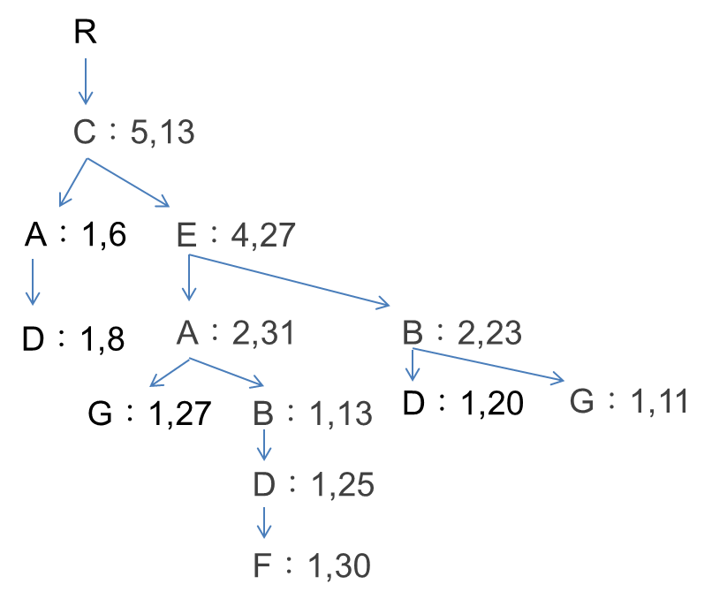
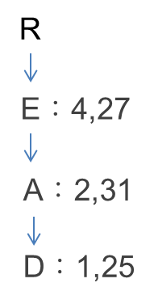
Assume：border_min_util = 15
Header table
Item | A | B | C | D | E | F | G
miu | 5 | 4 | 1 | 2 | 3 | 5 | 2
mau | 10 | 8 | 6 | 12 | 6 | 5 | 5
TWU(F) = TU(T3) = 30, MAX(F) = 5*1 = 5
Item | A | B | C | D | E
Path utility | 31 | 13 | 13 | 25 | 27
conditional
UP-Tree for F：
TWU(DF) = TU(T3) = 30, MAX(DF) = (12+5)*1 = 17
MIU(DF) = (2+5)*1 = 7 < border_min_util = 15
TWU(AF) = TU(T3) = 30, MAX(AF) = (10+5)*1 = 15
MIU(AF) = (5+5)*1 = 10 < border_min_util = 15
TWU(EF) = TU(T3) = 30, MAX(EF) = (6+5)*1 = 11
PKHUIs = ( {AF}, {DF} )

Slide 29
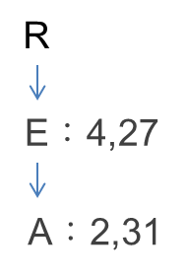
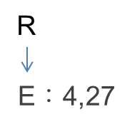
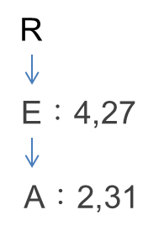
AF
border_min_util = 15
conditional
UP-Tree for AF：
TWU(EAF) = TU(T3) = 30
MAX(EAF) = (6+10+5) = 21
MIU(EAF) = (3+5+5)*1 = 13 < border_min_util = 15
Item | A | B | C | D | E | F | G
miu | 5 | 4 | 1 | 2 | 3 | 5 | 2
mau | 10 | 8 | 6 | 12 | 6 | 5 | 5
PKHUIs = ( {AF}, {DF}, {EAF} )
DF
TWU(ADF) = TU(T3) = 30
MAX(ADF) = (10+12+5) = 27
MIU(ADF) = (5+2+5)*1 = 12 < border_min_util = 15
TWU(EDF) = TU(T3) = 30
MAX(EDF) = (6+12+5) = 23
MIU(EDF) = (3+2+5)*1 = 10 < border_min_util = 15
conditional
UP-Tree for DF：
PKHUIs = ( {AF}, {DF}, {EAF}, {ADF},{EDF} )

Slide 30
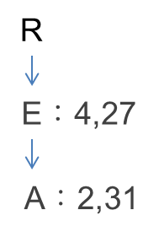
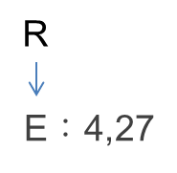
border_min_util = 15
ADF
conditional
UP-Tree for ADF：
Item | A | B | C | D | E | F | G
miu | 5 | 4 | 1 | 2 | 3 | 5 | 2
mau | 10 | 8 | 6 | 12 | 6 | 5 | 5
TWU(EADF) = TU(T3) = 30
MAX(EADF) = (6+10+12+5) = 33
MIU(EADF) = (3+5+2+5)*1 = 15 ≤ border_min_util = 15
PKHUIs = ( {AF}, {DF}, {EAF}, {ADF},{EDF},{EADF} )

Slide 31
Phase II Identifying top-k high utility itemsets from PKHUIs
Exact utilities of PKHUIs are identified and top-k high utility itemsets are examined by scanning the original database.

Slide 32
Outline
Introduction
Problem definition
Mining top-k high utility
Baseline approach
Effective strategies
Experiments
Conclusion

Slide 33
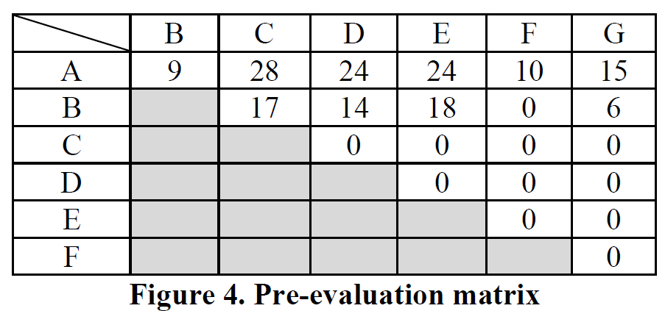
Effective strategies – Phase I
Strategy 2. Pre-Evaluation (PE)
Raise border_min_util at pre-evaluation step, before construct UP-Tree.
u(AC)
T1：u(AC,T1) = (5*1) + (1*1) = 6
u(AD,T1) = (5*1) + (2*1) = 7
T2：u(AC,T2) = (5*2) + (1*6) = 16
u(AE,T2) = (5*2) + (3*2) = 16
u(AG,T2) = (5*2) + (1*5) = 15
T3：u(AB,T3) = 9, u(AC,T3) = 6, u(AD,T3) = 17
u(AE,T3) = 8, u(AF,T3) = 10
T4：u(BC,T4) = 11, u(BD,T4) = 14, u(BE,T4) = 11
T5：u(BC,T5) = 6, u(BE,T4) = 7, u(BG,T5) = 6
u(AC) = 6 + 16 + 6 = 28
If k = 4, border_min_util = 18

Slide 34
Strategy 3. Raising the threshold by Node Utilities (NU) during the construction of the UP-Tree
If there are more than k nodes in the current UPTree
k-th highest node utility ≥ border_min_util
border_min_util = k-th highest node utility
Strategy 4. Raising the threshold by MIU of Descendents (MD) after the construction of UP-Tree and before the generation of PKHUIs.
For each node Nα under the root in the UP-Tree, calculate the MIU with its descendent node Nβ
If there are more than k MIUs larger than border_min_util
border_min_util = k-th highest MIU(Nα Nβ)

Slide 35
Effective strategies – Phase II
Strategy 5. Sorting candidates & raising threshold by the exact utility of candidates. (SE)
The candidates are sorted by the descendent order of estimated utilities, i.e., min(TWU(X), MAU(X))
If there are more than k HUIs whose exact utilities are larger than border_min_util
border_min_util = k-th highest exact utility
If candidate Z’s min(TWU(Z), MAU(Z)) < border_min_util
remaining candidates do not need to be checked

Slide 36
Outline
Introduction
Problem definition
Mining top-k high utility
Baseline approach
Effective strategies
Experiments
Conclusion

Slide 37
Datasets
Foodmart and Chainstore contain unit profits and purchased quantities.
Mushroom unit profits are generated between 1 and 1000 by log-normal distribution and quantities are generated randomly between 1 and 5.

Slide 38
Experiments
UPOptimal：the threshold is optimal minimum utility threshold.

Slide 39
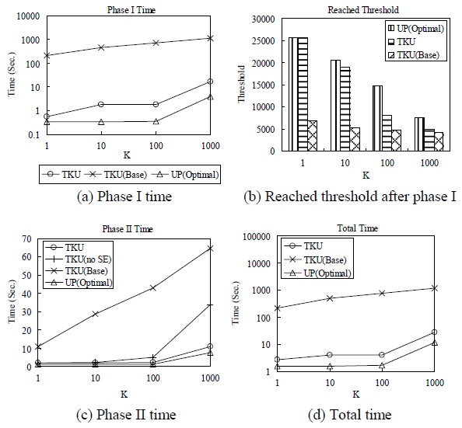
Foodmart

Slide 40
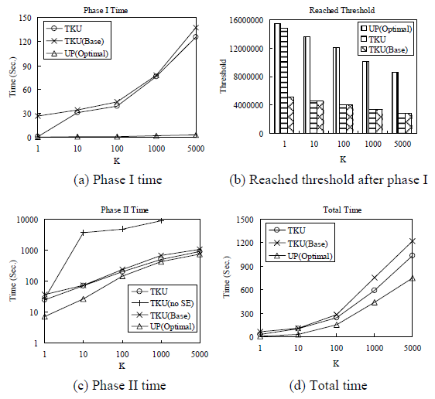
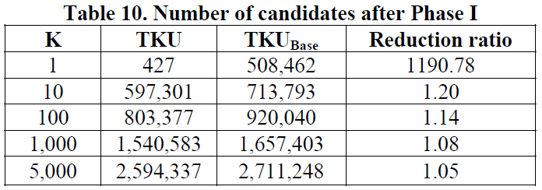
Mushroom
TWU values of itemsets are much larger than their exact utilities.

Slide 41
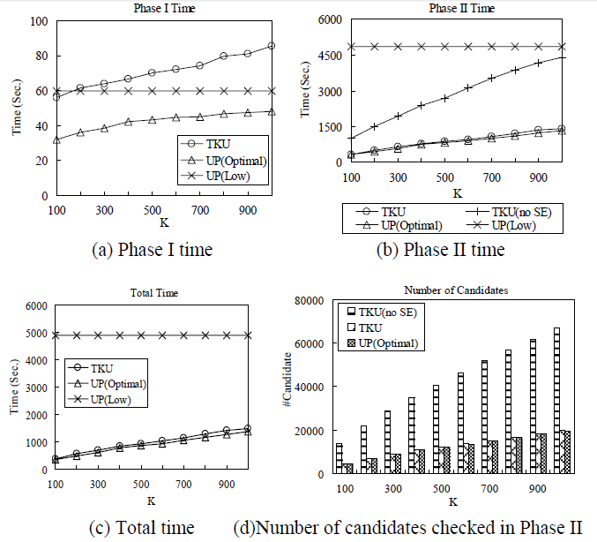
Chainstore
UPLow：UP-Growth with a low minimum utility threshold.

Slide 42
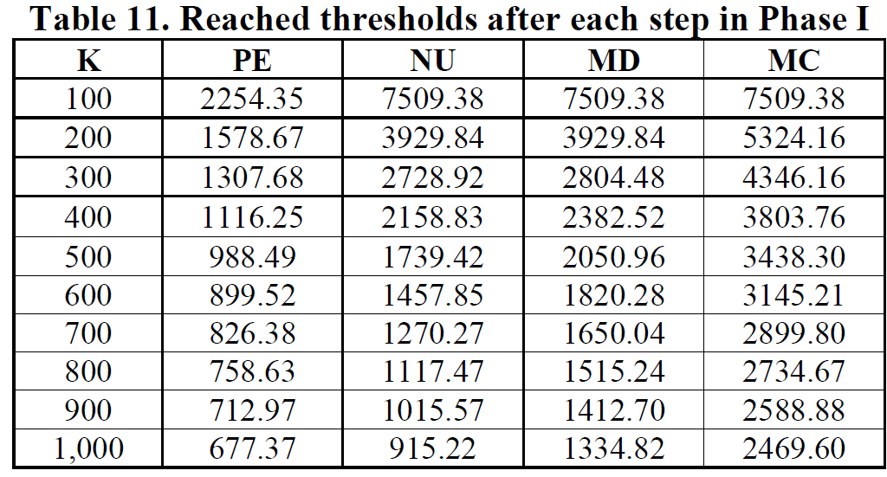

Slide 43
Outline
Introduction
Problem definition
Mining top-k high utility
Baseline approach
Effective strategies
Experiments
Conclusion

Slide 44
Conclusion
An efficient algrorithm named TKU for mining top-k high utility itemsets.
Four strategies for phase I to raise the border minimum utility threshold and reduce the search space and number of generated canditions.
A strategy is designed for phase II to decrease the number of checked candidations.

